Slide 1

FAKE SOCIAL MEDIA PROFILE DETECTION AND REPORTING
By:
Monika Dalal (AD21033)
Shally Nagfase (AD21037)
Maheshwari Bawankule (AD21043)
Akshata Udapurkar (AD22D004)
Under the guidance of
Mrs. Kalyani Pendke

Slide 2
Table of contents
01
04
02
05
03
06
Introduction
Uses
Related Work-Spam Detection
Tools & Technologies
Flowchart
Conclusion

Slide 3
Introduction
Fake profile detection is a critical area in online social networks, aimed at distinguishing between genuine and fraudulent accounts, specifically on Facebook.
Machine learning techniques play a pivotal role in this domain by enabling the development of algorithms that can automatically classify profiles based on various features extracted from the data.
These algorithms, such as Support Vector Machine (SVM), XG Boost, Random Forest, Neural Networks, and Naive Bayes, are trained on large datasets to identify patterns and anomalies indicative of fake profiles.

Slide 4
Related Work-Spam Detection
In order to detect fake identities created by human and bots, we looked towards past research addressing same problems such as spam behavior found in emails.
Machine learning has been used to not only detect bots on SMPs but also their intent.
Fake identities can be detected by detection of fake content linked to the account, investigating the account profile itself or using non verbal indicators.

Slide 5
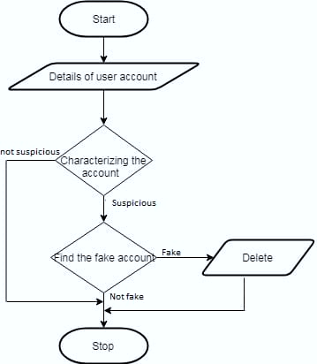
Flowchart

Slide 6
Tools & Technologies
Machine Learning Techniques : Random forest, Support vector Machine, Neural Network.
Python and Libraries like Sklearn, pandas & Numpy.
API

Slide 7
Advantage
It focuses on quantifying, profiling and understanding malicious applications.
User information is secure.
Avoid using distinct client IDs in the setup of the app.
Decrease Fake Account possibilities.
Reduce cybercrime.

Slide 8
Solution
To address the issue of fake profile detection on Facebook using machine learning, several solutions have been proposed in the research.
One key approach involves training machine learning algorithms to classify accounts as genuine or fake based on various features extracted from profiles. These algorithms, such as Support Vector Machine (SVM), XG Boost, Random Forest, Neural Networks, and Naive Bayes, are utilized to process large datasets of accounts, enabling automated classification without manual evaluation.

Slide 9
Conclusion and Future Work
We can conclude that it has been successful in addressing the issue of fake profile on social media platforms like Facebook.

Slide 10
References
Vayansky, Ike & Kumar, Sathish. (2018). Phishing – challenges and solutions. Computer Fraud & Security. 2018. 1520. 10.1016/S1361-3723(18)30007-1.
Alqatawna, Ja’far & Madain, Alia & Al-Zoubi, Ala & AlSayyed, Rizik. (2017). Online Social Networks Security: Threats, Attacks, and Future Directions. 10.1007/978-3-319-55354-2_10.
Jain, Neelesh & Shrivastava, Vibhash & , Professor & Professor, Assistant. (2014). "CYBER CRIME CHANGING EVERYTHING – AN EMPIRICAL STUDY".

Slide 11
Thank You

